Slide 1


Slide 2
TOPIC NAME:- electric vehicle charging planner
Pavan :-25MVCSMR0657
Ashok:-25MVCSMR0667
Ajay :-25MVCSMR0668
srinad:-25MVCSMR0677

Slide 3
ALGORITHM DESIGN · EV PLANNING
EV Charging Planner
Feasible routes, visible reasoning
Recommend charging stations and least-cost routes while making every algorithmic decision visible.
Graph model · Dijkstra · greedy recommendations · React + Flask

Slide 4
THE PLANNING PROBLEM
The planner balances three real constraints
A route is useful only when it can be driven, charged, and justified.
01
02
03
Battery reach
Live availability
Route cost
Battery level limits which stations and roads are reachable.
Station availability changes which stops are feasible now.
Travel distance becomes the route cost to minimize.

Slide 5
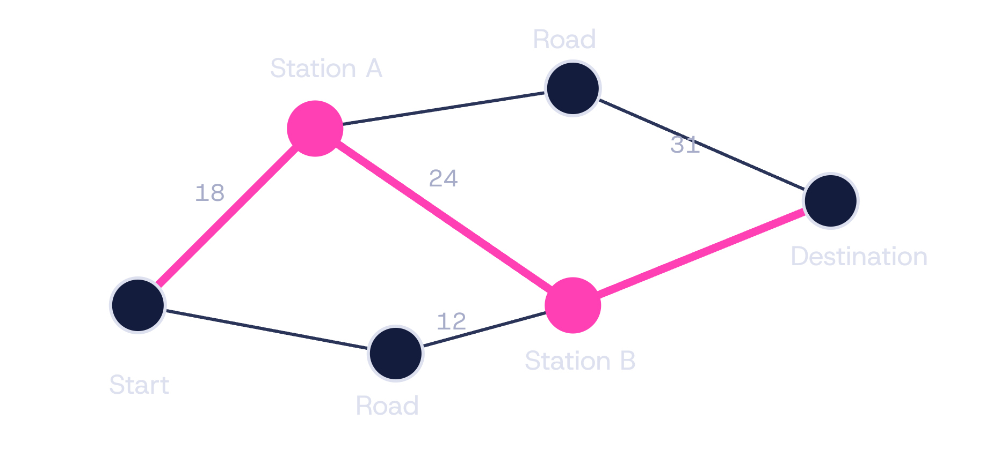
01 · GRAPH MODEL
Model the journey as a weighted graph
The map becomes a searchable structure: locations and charging stations are nodes; drivable connections are edges with non-negative distance costs.
Each station stores availability, charging impact, and optional wait or detour cost.

Slide 6
02 · SEARCH CONTROL
Priority Queue keeps the search focused
At every iteration, the next node is the one with the lowest tentative route cost.
01
02
03
04
Seed
Pop
Relax
Trace
Insert the start node with tentative cost 0.
Remove the cheapest unexplored node.
Update reachable neighbors and priorities.
Record predecessors for reconstruction.

Slide 7
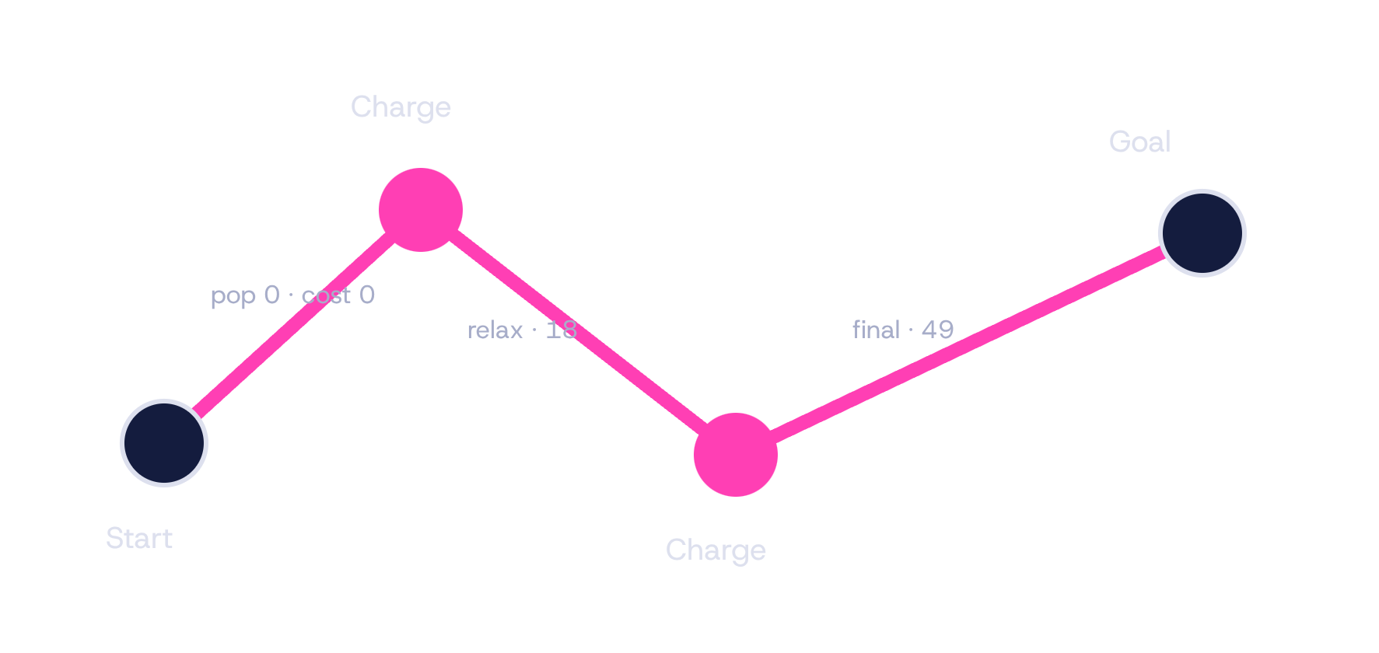
03 · LEAST-COST SEARCH
Dijkstra finds the least-cost feasible route
Feasibility comes first. Cost comparison happens only among edges the current battery can cover.
Skip edges the current battery cannot cover.
Update a neighbor only when the new route cost is lower.
Stop when the destination is finalized.
Return the path, total distance, visited nodes, and charging stops.

Slide 8
04 · LOCAL DECISION LAYER
Greedy recommendations make the next stop obvious
The recommender narrows the choice to stations that are reachable now, then exposes why one local option wins.
Filter
Rank
Repeat
Reachability and current availability remove impossible stops.
Score low detour, high battery gain, and short wait.
Select the best local option, then recompute from the new battery state.

Slide 9
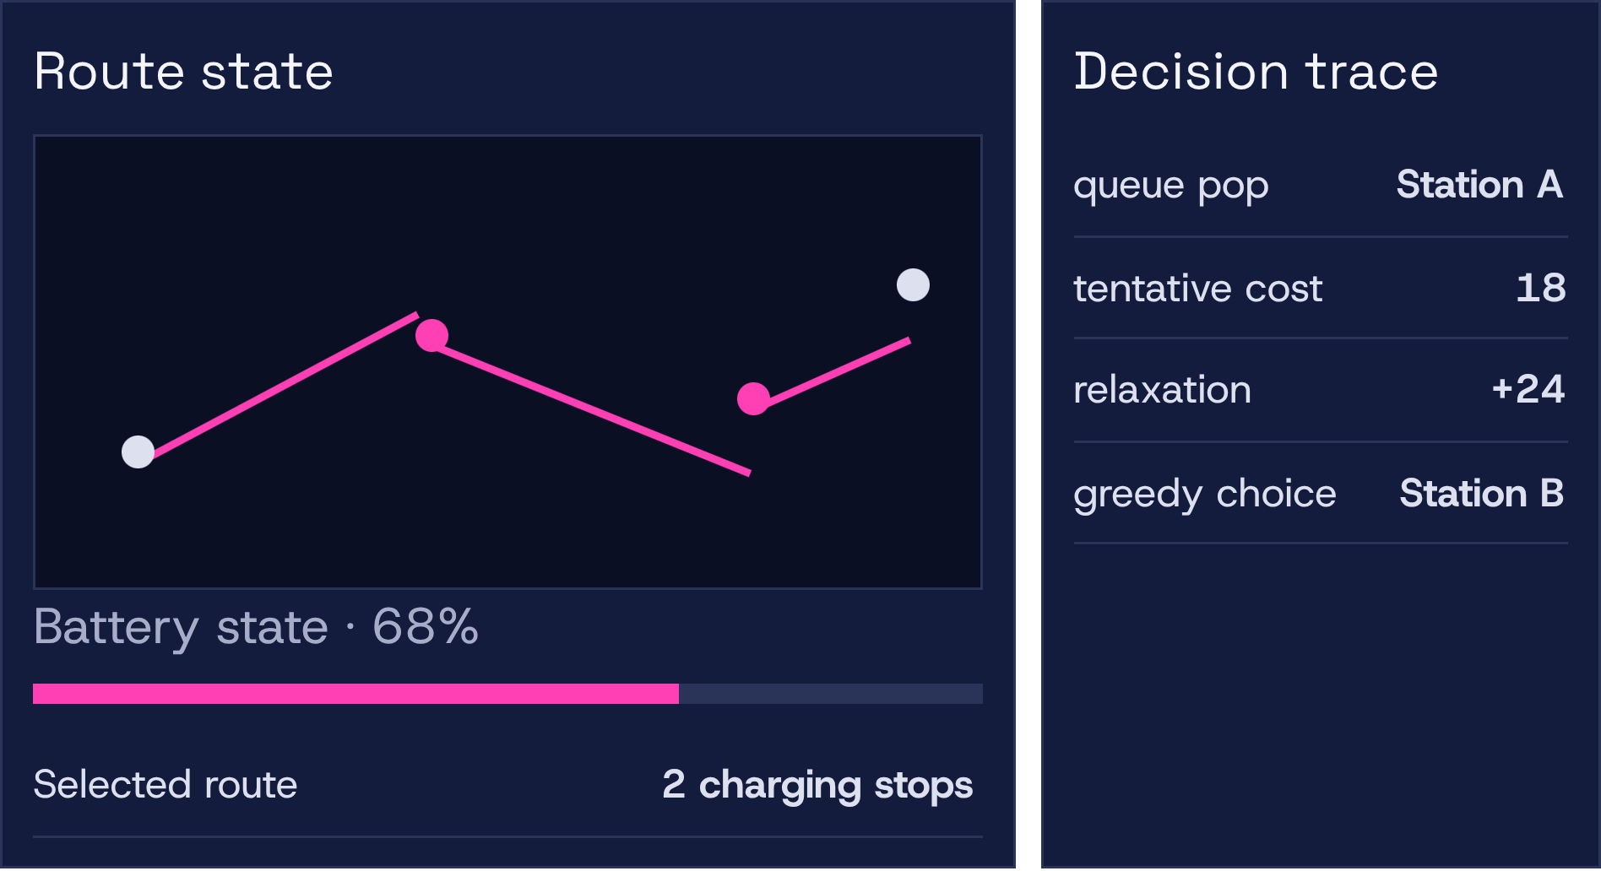
05 · EXPLAINABLE INTERFACE
The interface exposes the algorithm’s reasoning
The UI turns internal state into inspectable evidence rather than hiding it behind a single route line.
React shows the map, battery state, available stations, and selected route.
Flask exposes inputs, route results, recommendation steps, and trace data.
A decision panel shows queue pops, tentative costs, relaxations, and greedy choices.

Slide 10
06 · EVALUATION
Compare strategies, not just final routes
Strategy | Strength | Risk | Explainability
Dijkstra | Optimizes the complete feasible route. | More search work. | Traceable queue and relaxations.
Greedy | Reacts quickly at each stop. | Can miss a better downstream option. | Transparent local score.
Compare | Distance and number of stops. | Wait or detour cost and runtime. | Explanation depth.
Use the same request and constraints so the tradeoff is visible, not anecdotal.

Slide 11


